Slide 1


U.S. Census Data for 2015 & 2017
Team Members:
Minerva Banuelos
Matthew Hutcherson
Alison Litton
Kristi Mar
Charlie Martinez

Slide 2
Motivation & Summary To determine the best state to live within the U.S. Factors examined are unemployment rates, income average, poverty rates, workforce types, and population. The two datasets we used are: - US Census Demographic Data for 2015 - US Census Demographic Data for 2017

Slide 3

Hypothesis
The best states to reside in based on Income Average and Commute Time Average.
Null: There is no statistical difference in Income Average and Commute Time Average between comparison.
Alternative: There is a significant statistical difference in Income Average and Average Commute Time between compared states.

Slide 4

Data Cleaning & Exploration
How we found our data
Cleaning Process:
Conversion of values
Dropped nulls and filling in blank s
Renaming columns once we determined the significance of some
Insights:
Initial view of the data seemed very straight forward
We did not anticipate the amount of time and energy we need ed to spend cleaning the data
Disclaimers:
Original dataset did not explain how each column was calculated
We standardized our dataset values based off Total Population

Slide 5

Questions
1) Does the total population have a correlation to unemployment?
2) Does the increase or decrease adult population impact poverty rates?
3) Does commute time influence income average?
4) How does the state’s population make-up the different workforce types?
5) Do states with higher income average correlate to workforce types?

Slide 6
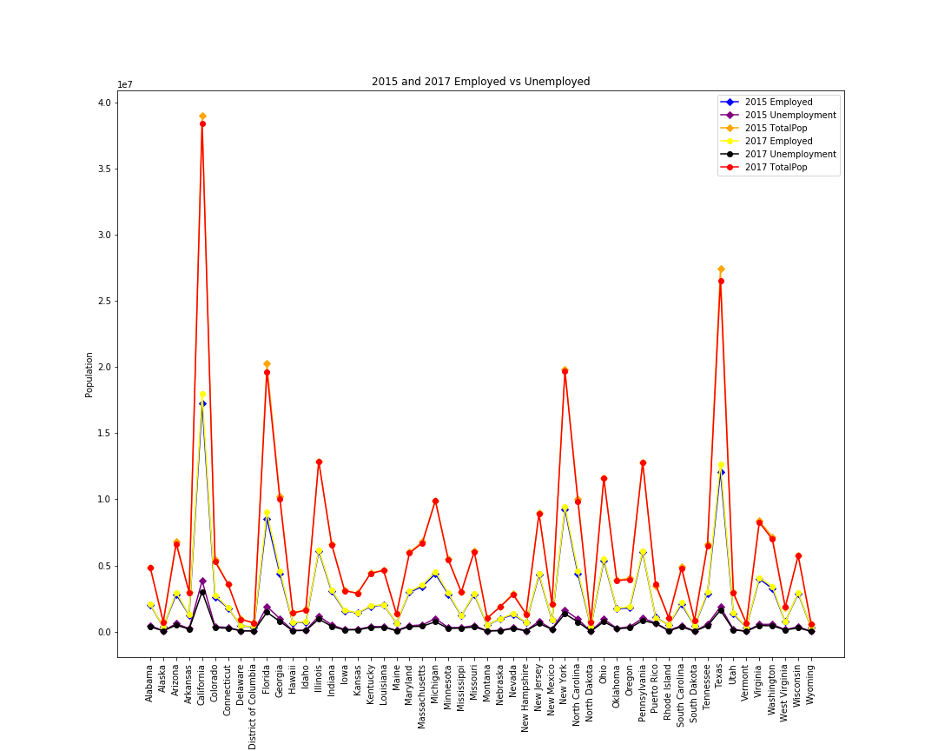
Total Population vs. Unemployment Rates
Findings:
No impact exists between total population and unemployment.
The illustration reveals a pattern of employment and unemployment with total population.
When the employment increases, unemployment decrease. It is prevalent when looking at a high populated state like CA.

Slide 7
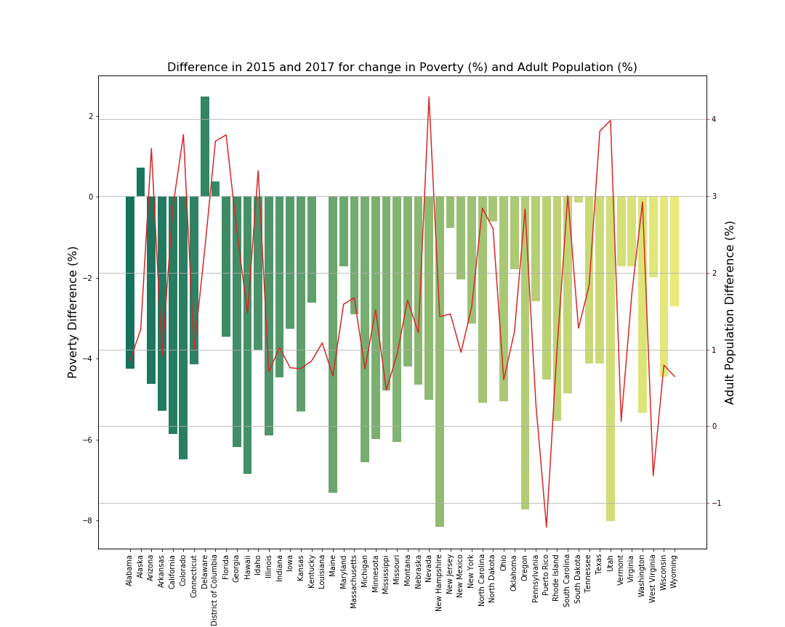
Adult Population vs. Poverty Rates
Findings:
Poverty decreased in 2017 from 2015
Adult population increased in majority of states
The overall percentage numbers of both poverty and adult population run mostly in tandem with each other

Slide 8
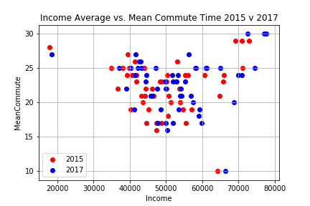
Commute Time vs. Income Average
Findings:
A correlation exists with income average and mean commute time of 15 to 25 minutes with income of $40,000 to $60,000
Commuters with highest income averages

Slide 9
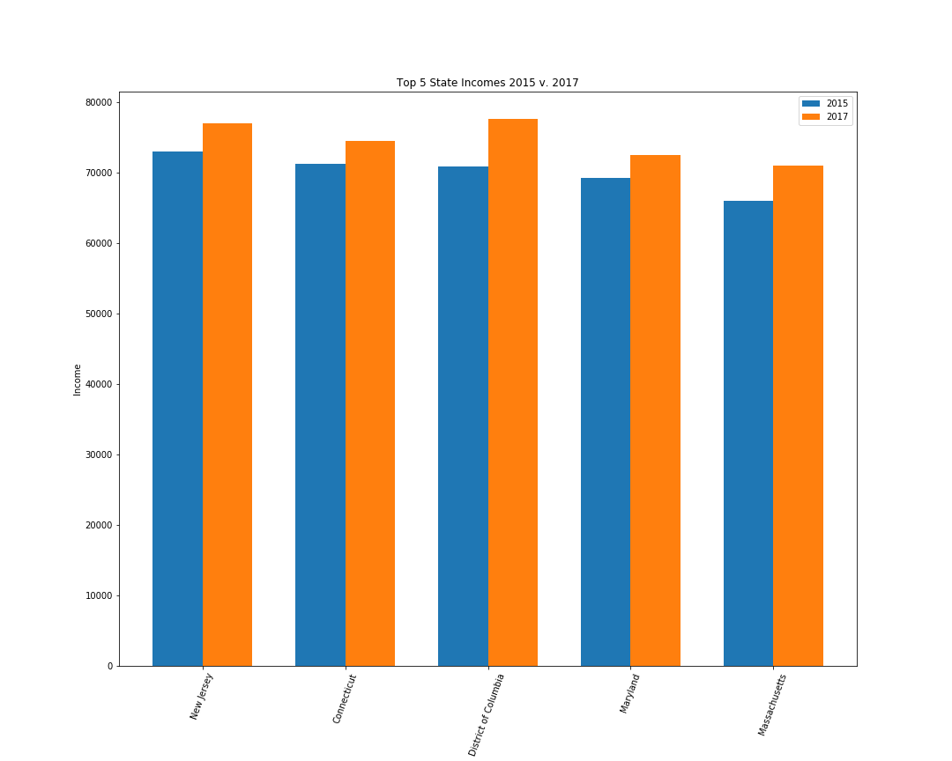
Top Five States with Highest Income
Findings:
Five states were consistent between both years with highest income average

Slide 10
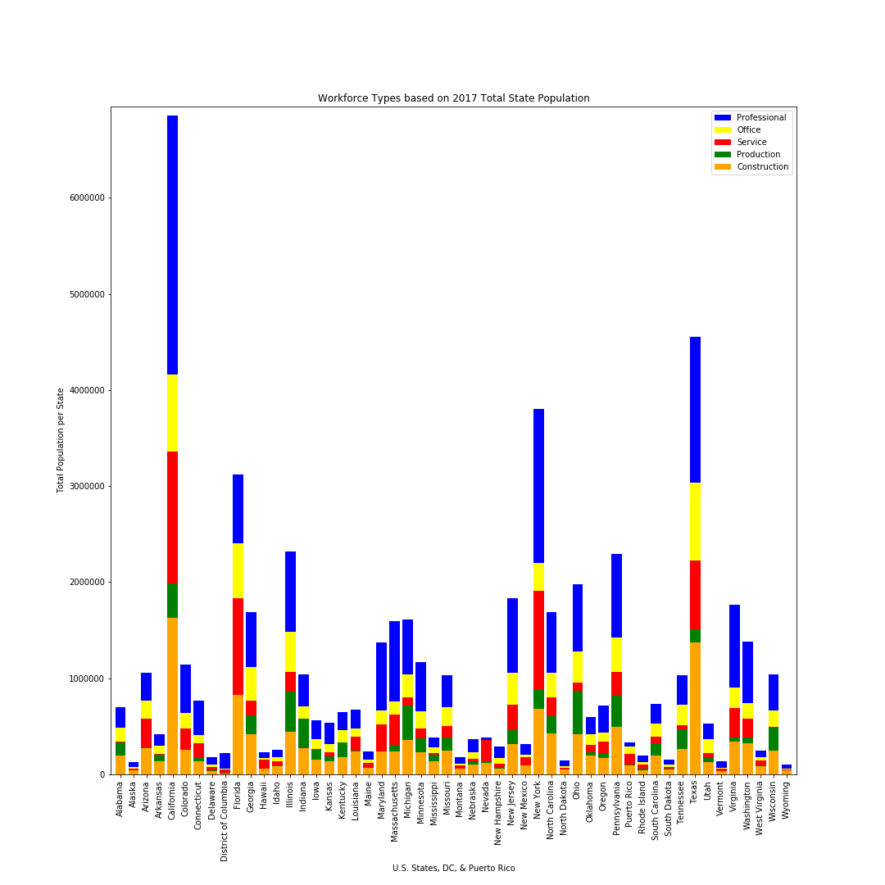
Workforce Types per State
Findings:
The 2015 and 2017 data for workforce types are visually similar
The Professional field represents the majority of the country’s workforce
The data is based on subjective answers

Slide 11
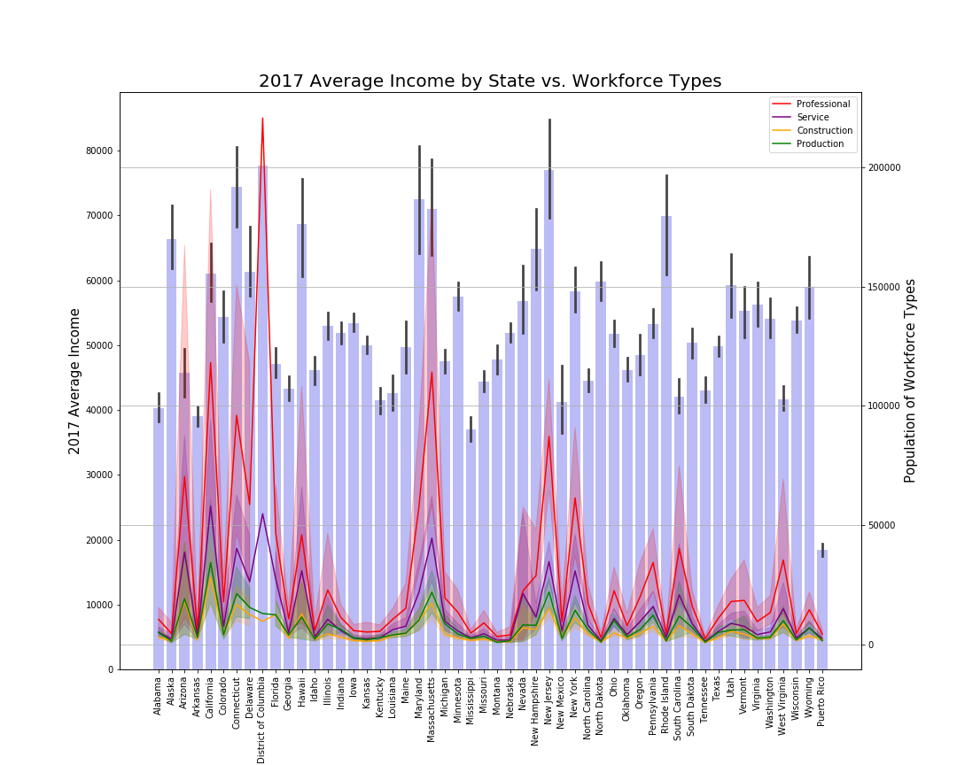
Average Income vs. Workforce Types
Findings:
The professional workforce type represents the largest group
The approximate national average is 37%

Slide 12
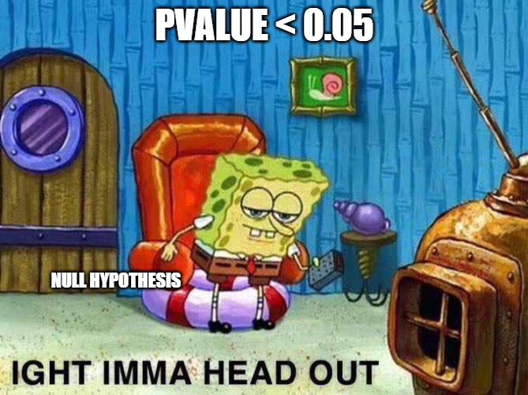
T-Test Results
Example:
Connecticut vs California
Q: Is there a statistical difference when comparing two states in Income Average and Average Commute Time?
A: We performed a series of Independent T-Tests to figure if there is a statistical difference between one state and another.
2015 Average Income | 2017 Average Income
P-Value = 0.00160 | P-Value = 0.00458
P-Value < 0.05 Therefore, we reject the null hypothesis | P-Value < 0.05 Therefore, we reject the null hypothesis
Translates to there is a statistical difference | Translates to there is a statistical difference
2015 Average Commute Time | 2017 Average Commute Time
P-Value = 0.69833 | P-Value = 0.60383
P-Value > 0.05 Therefore, we fail to reject the null hypothesis | P-Value > 0.05 Therefore, we fail to reject the null hypothesis
Translates to there is no statistical difference | Translates to there is no statistical difference

Slide 13

Conclusion
The two factors used in the T-Test yielded inconclusive results.
Therefore, we cannot reject nor fail to reject the null hypothesis.

Slide 14
Lessons Learned
Discovering the data prior to having an idea
Adjust after first data source
Have an idea prior to discover data
Limited data with open sources
Interpretation of data (voting age citizen vs population)
Slight misdirection of hypothesis
Pivoted once data mined
Very Socratic

Slide 15
Q & A

